Slide 1
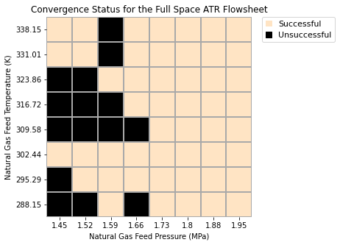
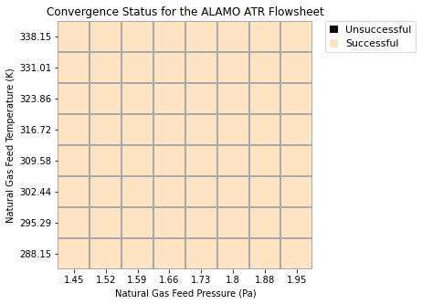
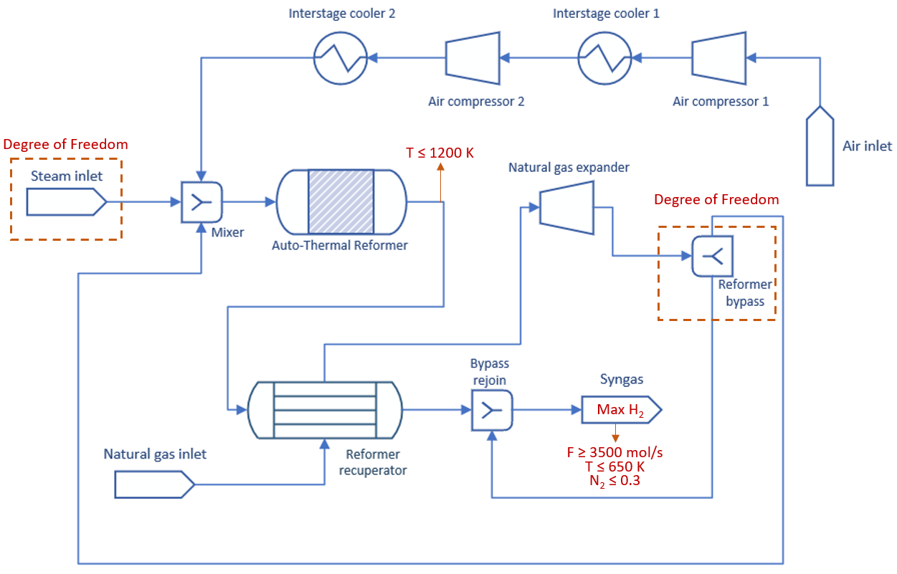
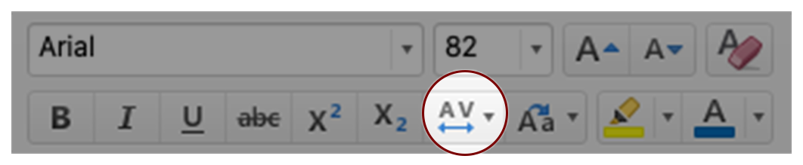
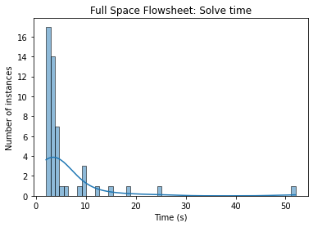
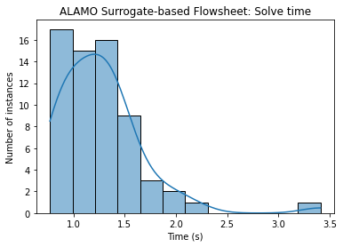
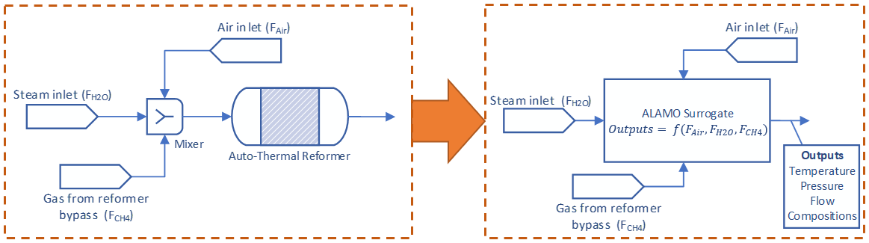
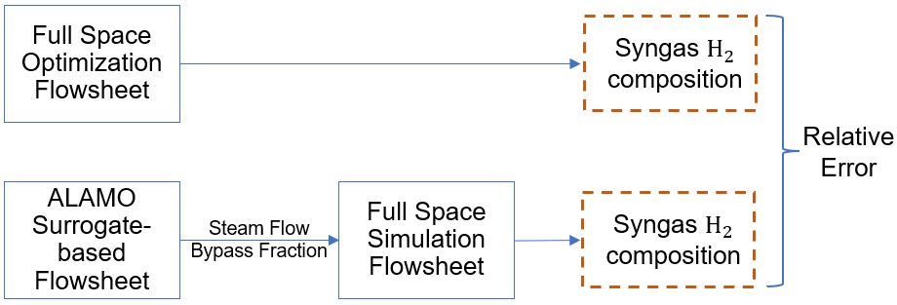
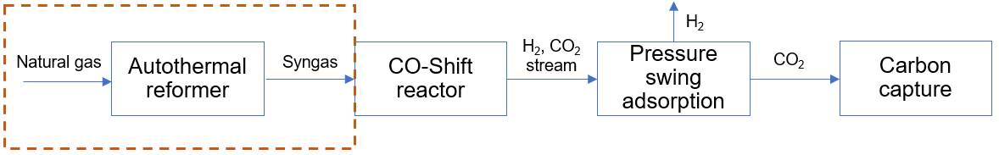
Type is Arial→
Machine Learning for Chemical Process Optimization
Sergio Bugosen^{1,2}, MS; Robert Parker¹, PhD; Carleton Coffrin¹, PhD. | ¹A-1 Information Systems & Modeling; ²Department of Chemical Engineering, Carnegie Mellon University
←Additional Logos can be placed in line with the blue Principal Investigator and Affiliations box.
Go to View>Guides to view layout guidelines.
Motivation
CHEMICAL PROCESS DESIGN AND OPTIMIZATION
A fundamental task in chemical process design is the selection of optimal operating conditions that satisfy product specifications, as well as safety and economic constraints. However, classical optimization of a chemical process flowsheet is challenging due to:
Number of variables and algebraic equations defining each unit operation.
Nonlinear complexity of the first principles models.
The optimization problem heavily depends on converging the large system of algebraic equations defining the flowsheet.
Methods
Results
CONVERGENCE RELIABILITY
The full space formulation was able to converge 49 out of 64 instances, while the surrogate-based formulation converges all 64 instances.
SOFTWARE
Pyomo, an open-source optimization modeling language, and the IDAES framework (Institute for the Design of Advanced Energy Systems) were used to model the ATR flowsheets in Python 3.10.11. NLP solver used was IPOPT 3.13.2, linear solver MA27.
*Character spacing can be set in the Home Tab on the Toolbar below font name
FULL SPACE ATR FLOWSHEET
The goal is to maximize H₂ concentration in the syngas stream while satisfying the constraints shown in Chart 2. The degrees of freedom are the inlet steam flow and the bypass fraction.
MACHINE LEARNING IN CHEMICAL ENGINEERING
To reduce the complexity and number of equations, we utilize the Automated Learning of Algebraic Models (ALAMO) tool.
ALAMO is a machine learning model that provides tractable and simple polynomial functions to represent complex unit operations.
Optimization of a chemical process flowsheet that uses ALAMO will improve convergence reliability and solve times.
Chart 5. Convergence status for each formulation.
Vertical Spacer Between Sections– DO NOT PRINT
PERFORMANCE
The ALAMO surrogate-based formulation is faster than the full space by a factor of five, and the solution time between instances on this parameter sweep is more uniform, with a standard deviation that is sixteen times lower.
Formulation | # Variables | # Constraints | Avg. solve time (s) | Standard dev. (s)
Full Space | 897 | 895 | 5.97 | 8.02
ALAMO | 451 | 449 | 1.26 | 0.42
“Replace complex reaction engineering equations with tractable, simple polynomials.”
Chart 2. Full space ATR flowsheet displaying objective and constraints.
ALAMO SURROGATE-BASED ATR FLOWSHEET
This flowsheet was modeled exactly as the one in Chart 2. Main difference is that instead of using a first principles reactor, we use a surrogate model block consisting of simple polynomials.
OBJECTIVE
Compare convergence reliability, solve time and solution quality between classical (or full space) and surrogate-based optimization formulations.
Primary LANL Blue
CHEMICAL PROCESS DESCRIPTION
This project will focus on optimizing the autothermal reformer (ATR) section of a low-carbon hydrogen manufacturing process. The objective of the ATR process is to produce syngas, a mixture mainly composed of H₂, CO, CH₄ and CO₂. First, a mixture of natural gas, steam and air is fed into the reactor. The hot syngas is then circulated through a shell and tube heat exchanger, also called the reformer recuperator, to heat the natural gas feed. This natural gas feed is then expanded to generate electrical power and is finally fed into the reactor, closing the loop.
Chart 6. Solve time distribution for each formulation.
SOLUTION QUALITY
The mean relative error between the objective values from the Full Space and ALAMO surrogate-based formulations is 1.47%, with a standard deviation of 0.51 and a maximum error of 3.04%.
Chart 3. Representation of a surrogate reactor block.
VALIDATION – SOLUTION QUALITY
The procedure shown in Chart 4 was employed to assess the discrepancy between solutions.
Future Work
Include an implicit function formulation in this comparison.
Compare these three formulations (Full Space, ALAMO surrogate-based, implicit) for a more complex chemical process, such as the carbon capture section of the plant.
Extend the surrogate-based formulation to dynamic optimization problems.
Extend the surrogate-based formulation to superstructure optimization problems.
Secondary LANL Blue
Chart 1. Block flow diagram of a low-carbon manufacturing process.
Chart 4. Representation of a surrogate reactor block.
Chart 1. Label in 24pt Arial
LA-UR# number goes here

